Slide 1

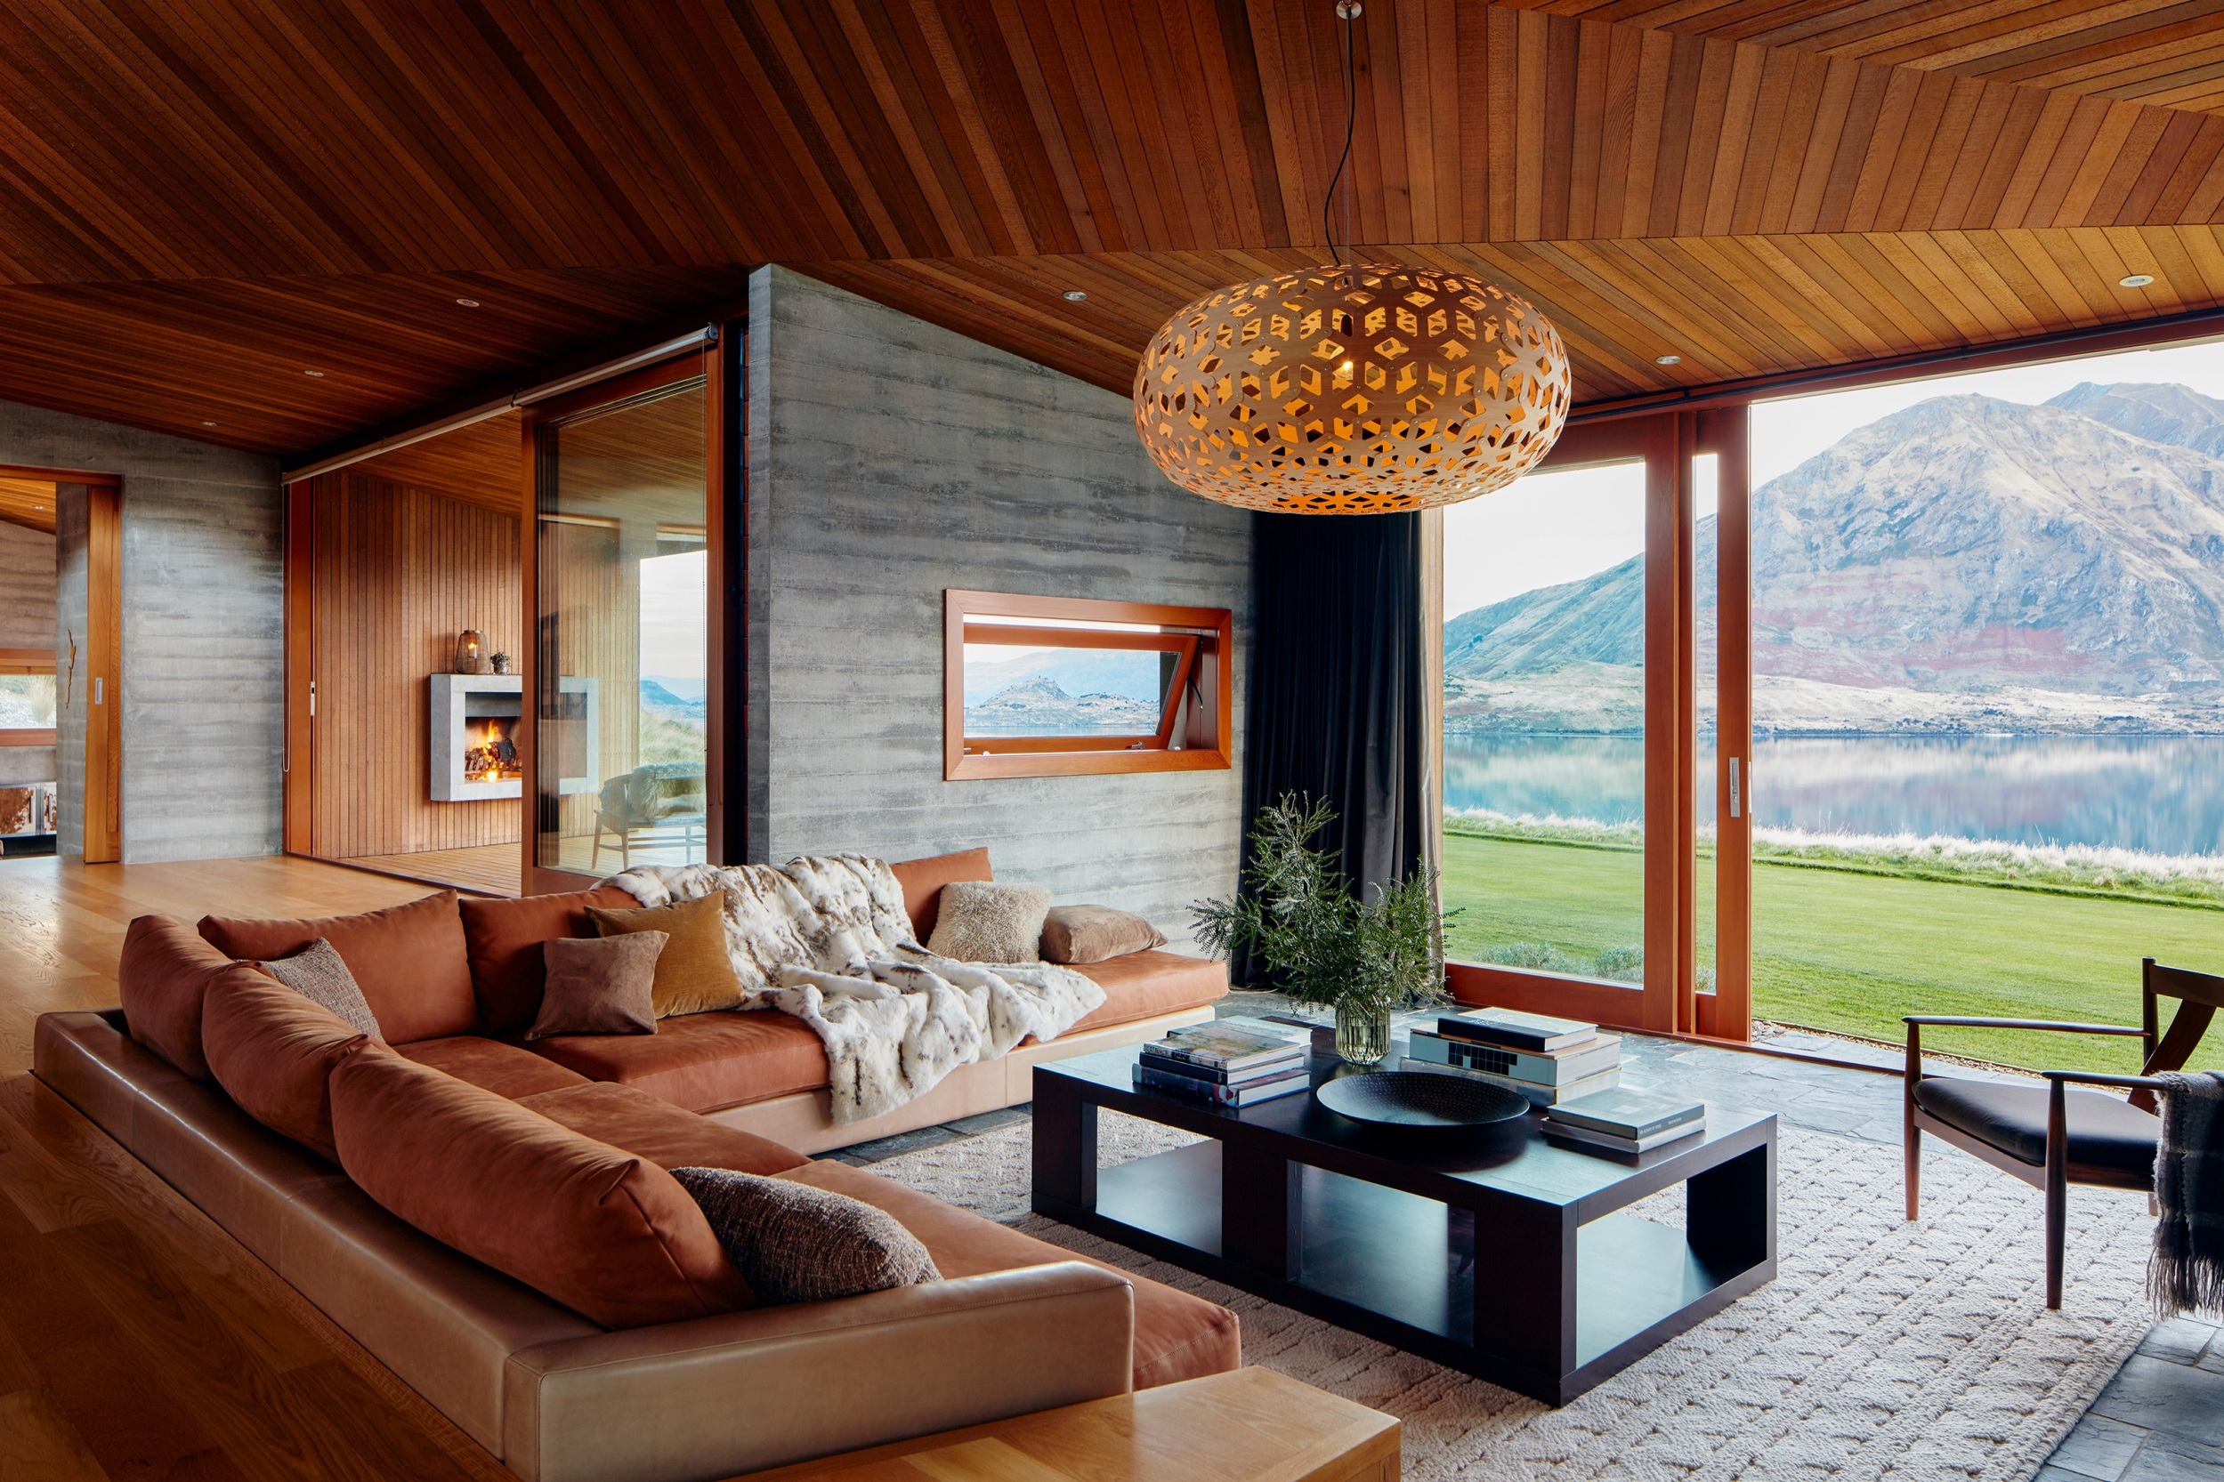

FROM IDEATION TO DISRUPTION: THE DESIGN THINKING JOURNEY OF AIRBNB
Belong Anywhere

Slide 2

CONTENT
INTRODUCTION
DESIGN THINKING
AIRBNB'S INNOVATION JOURNEY
CASE STUDY: AIRBNB'S WEBSITE REDESIGN
SUCCESS STORIES
Brian Chesky
CEO of Airbnb, Inc.
CONCLUSION

Slide 3
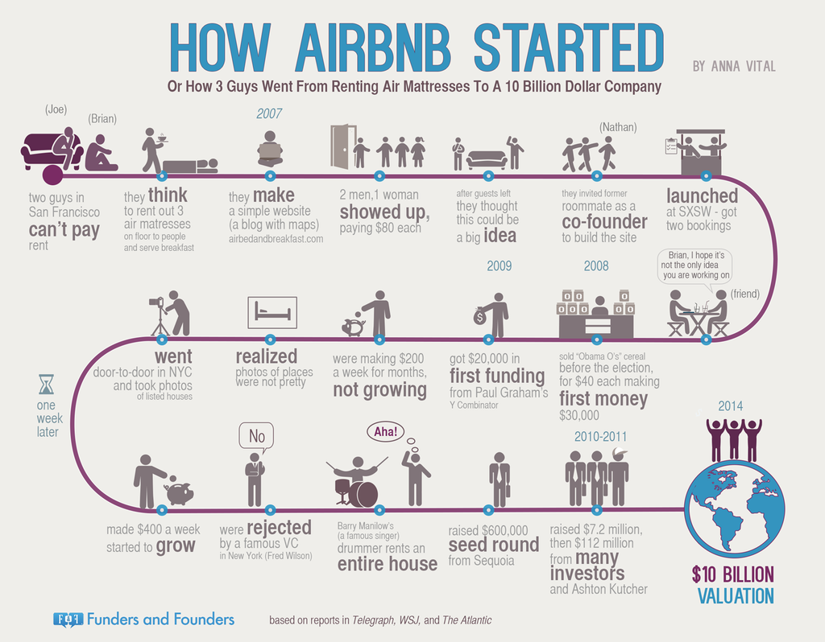
INTRODUCTION
Airbnb Is A Company That Has Revolutionized The Travel Industry By Making It Easier And More Affordable For People To Find Unique Places To Stay All Over The World. Founded In 2008, Airbnb Is A Platform That Connects People Who Need Accommodation With Those Who Have It. The Company Started When The Founders Couldn't Afford To Pay Rent, So They Decided To Rent Out Air Mattresses In Their Living Room. From There, The Idea Grew Into What Is Now A Multi-billion Dollar Company With Over 7 Million Listings Worldwide.

Slide 4
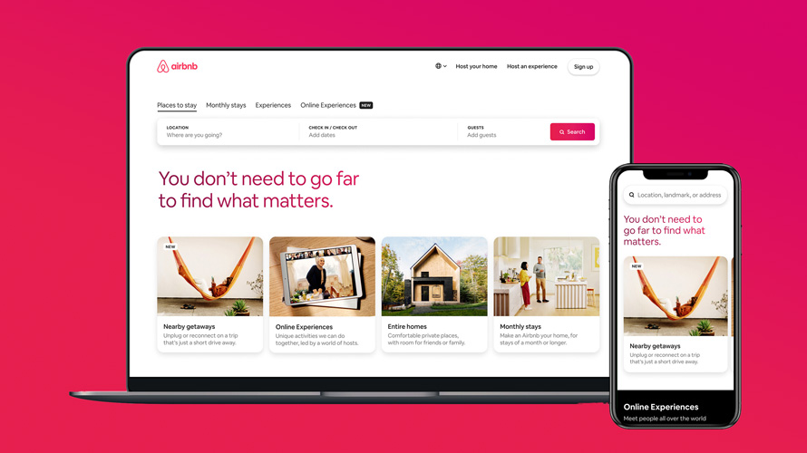
DESIGN THINKING
Design Thinking Is A Way To Solve Problems By Understanding The People Who Are Affected By Them.
Airbnb Uses Design Thinking To Make Its Website And Products Better.
For Example, Airbnb Used Design Thinking To Create Experiences, Which Lets Users Book Local Activities And Tours.
By Understanding What Users Want, Airbnb Was Able To Create A Successful Product That Fits With Its Brand.

Slide 5
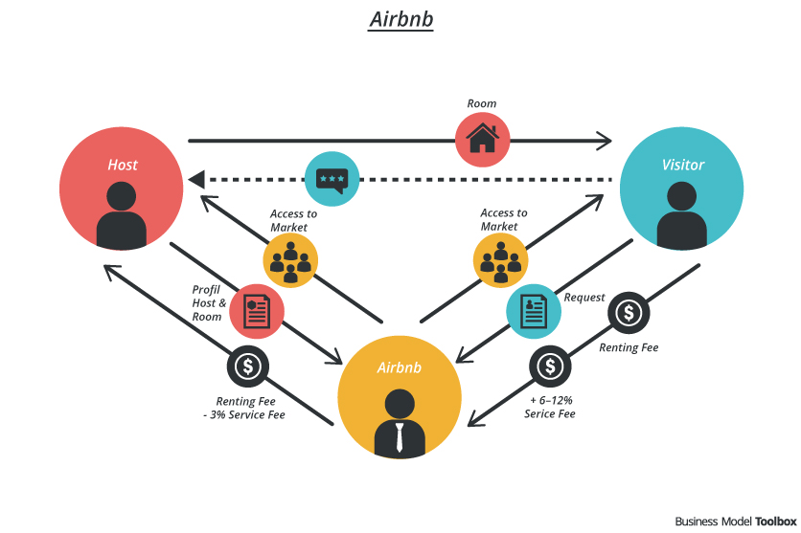
AIRBNB'S INNOVATION JOURNEY
Airbnb Has Used Design Thinking To Disrupt The Traditional Hospitality Industry By Creating A User Experience That Resonates With Travelers Around The World.
The Company Focuses On The Needs Of Its Users By Empathizing With Travelers And Hosts.
This Approach Has Helped Airbnb To Grow Rapidly And Build A Loyal Community Of Users.

Slide 6
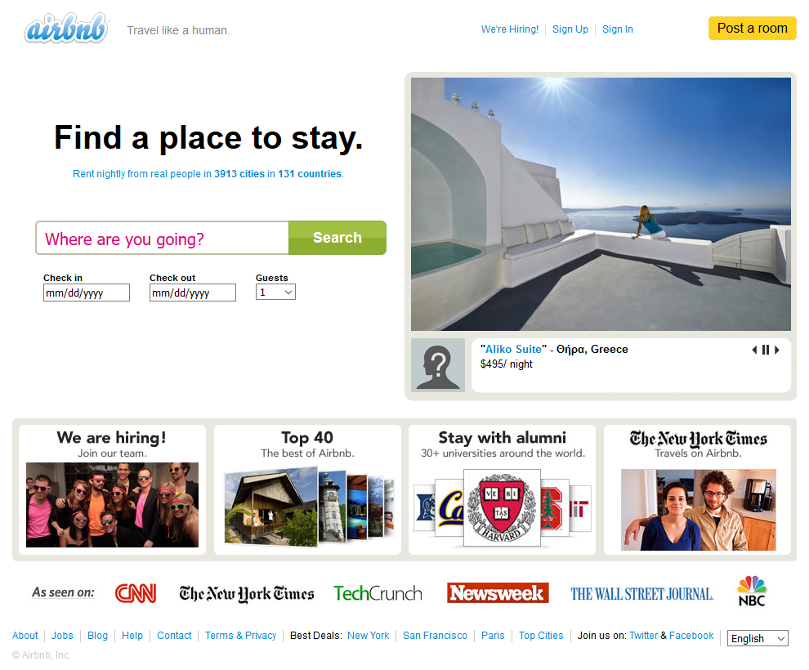
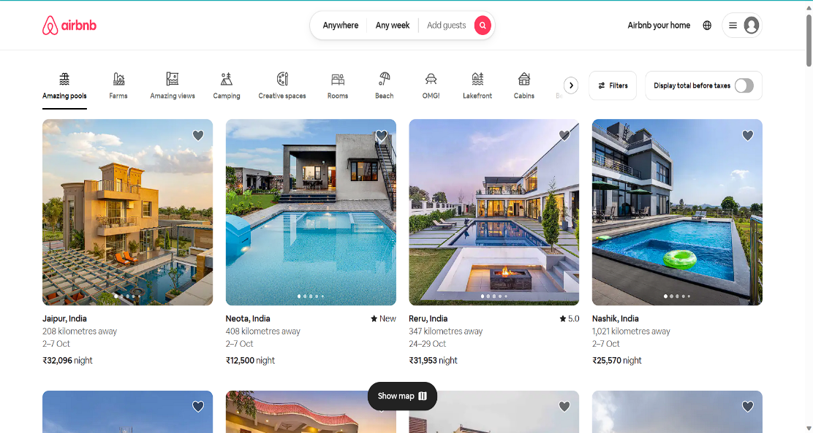
CASE STUDY: AIRBNB'S WEBSITE REDESIGN
Airbnb redesigned its website to make it easier for users to find what they were looking for.
They used design thinking to understand what users wanted and to test their ideas.
One of the key features of the redesign was personalized search results.
The team also focused on improving the booking process.
OLD DESIGN
NEW DESIGN

Slide 7
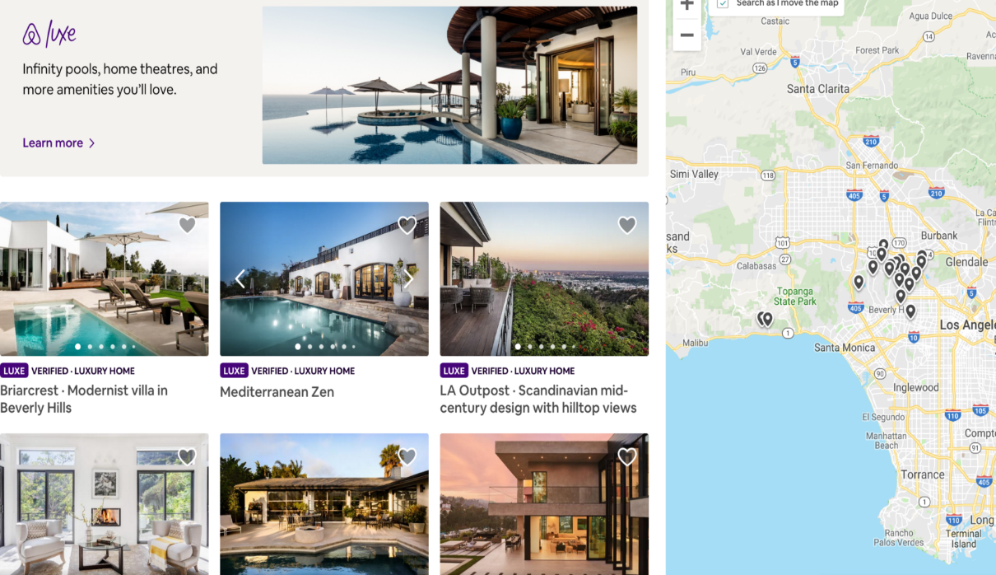
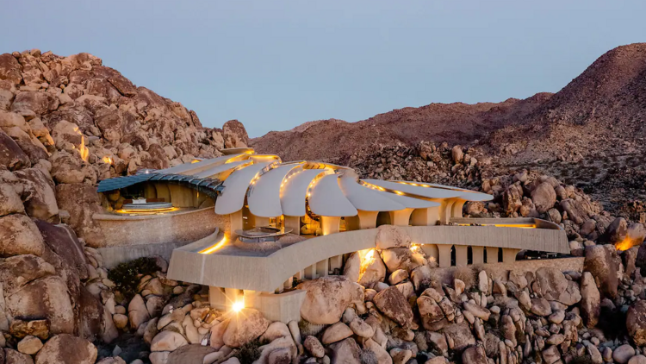
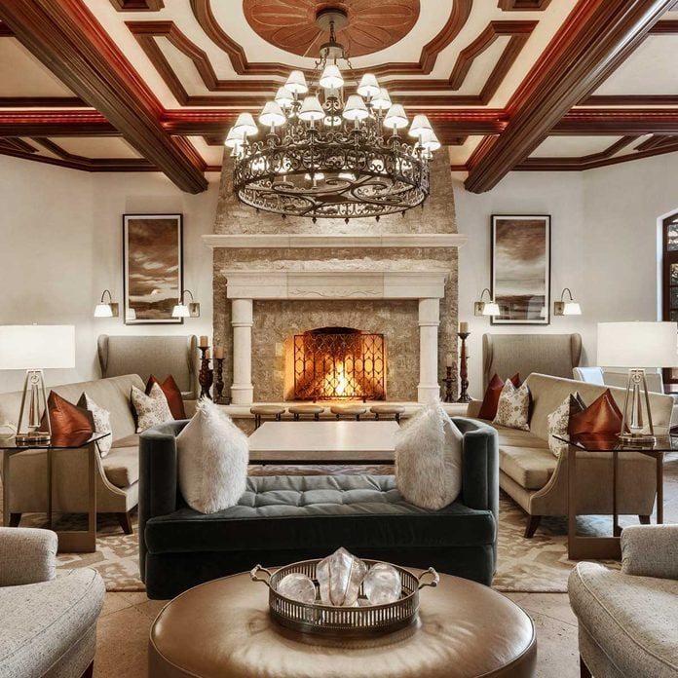
SUCCESS STORIES
LEARN MORE
AIR BNB LUX
Airbnb's Success With Experiences And Airbnb Luxe Is A Testament To The Company's Ability To Innovate And Meet The Needs Of Its Customers. Experiences Provides Travelers With A Unique And Authentic Way To Experience The Places They Visit, While Airbnb Luxe Offers Discerning Travelers The High-end Amenities And Personalized Service They Expect.
Both Experiences And Airbnb Luxe Are Powered By Airbnb's Focus On Creating A Seamless User Experience And Leveraging The Power Of Community. Experiences Are Hosted By Locals Who Have A Deep Understanding Of Their Area And Offer Travelers A Unique Perspective On The Local Culture. Airbnb Luxe Properties Are Carefully Curated To Meet The Highest Standards Of Comfort And Luxury, And Travelers Receive Personalized Concierge Services From Airbnb's Team Of Experts.
Airbnb's Success With Experiences And Airbnb Luxe Demonstrates The Company's Commitment To Providing Its Customers With The Best Possible Travel Experience. By Offering A Variety Of Options To Meet The Needs Of Different Types Of Travelers, Airbnb Is Positioning Itself As A Leading Travel Platform For The Future.

Slide 8
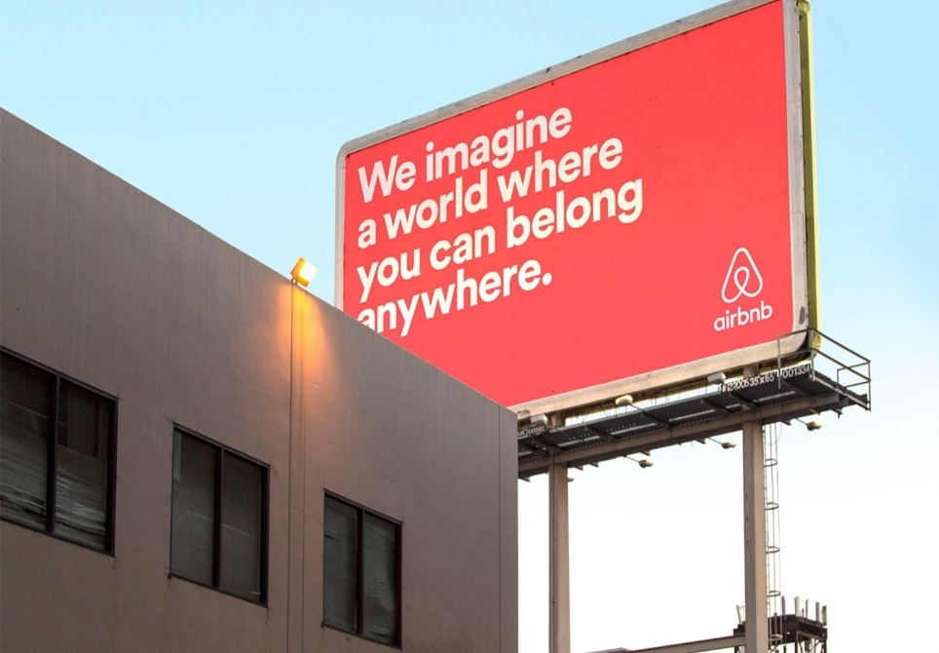
CONCLUSION
Design Thinking Is A Way To Solve Problems By Understanding The People Who Are Affected By Them.
Airbnb Used Design Thinking To Create New Products And Services That People Love.
For Example, Airbnb Used Design Thinking To Redesign Its Website And Create Its Experiences Platform.
Design Thinking Has Helped Airbnb Stay Ahead Of Its Competitors And Become A Leading Travel Platform.

Slide 9

T H A N K
YOU
DESIGNED & CREATED BY PRANEET
Belong Anywhere

